Slide 1
General Principles of Cervical preinvasive Disease
Dr. Shima Alizadeh
Gynecology Oncology Fellowship
Iran University of medical science

Slide 2
No conflict of interest

Slide 4
Cervical Intraepithelial neoplasia (CIN) since 1968
Dysplasia Cancer

Slide 6
Cervical intraepithelial neoplasia
A premalignant condition of the uterine cervix.
The ectocervix (surface of the cervix that is visualized on vaginal speculum examination) is covered in squamous epithelium,
The endocervix, including the cervical canal, is covered with glandular epithelium.
CIN refers to squamous abnormalities.
Glandular cervical neoplasia includes adenocarcinoma in situ and adenocarcinoma.

Slide 7
CIN Diagnosis
Cellular Immaturity
Cellular Disorganization
Nuclear Atypia
Mitosis

Slide 8
Metaplasia
Estrogen -> Glycogen in vaginal epithelium
Lactobacilli -> PH vaginal
Sub columnar reserve cell -> Metaplasia
Columnar -> Squamous

Slide 9
CIN 1
a low-grade lesion
mildly atypical cellular changes in the lower third of the epithelium
Human papillomavirus (HPV) cytopathic effect (koilocytotic atypia) is often present
4 percent CIN 1
5 percent for CIN 2,3

Slide 12
CIN
Anterior Lip
Sharp border
Transitional zone
Metaplasia
&
HPV infection

Slide 13
Risk for progression to cancer
AGE
<25 years have a lower risk of developing cervical cancer
CIN grade
HPV and cytology results preceding the diagnosis of CIN

Slide 15
LSIL
75% CIN 1
25% CIN 2,3
82% HPV+
Colposcopy

Slide 18
PATIENTS ≥25 YO WITH CIN1
Preceded by LSIL or less — Patients with CIN 1 preceded by
low-grade squamous intraepithelial lesion (LSIL),
atypical squamous cells of undetermined significance (ASC-US)
NILM but positive for human papillomavirus (HPV) are
Low risk for the development of cervical cancer

Slide 19
In a cohort study in which over 100,000 patients had colposcopy biopsies demonstrating CIN 1 and were followed for a decade, the risk of developing CIN 3+ when preceding cytology was LSIL or less was:
For LSIL, HPV-positive – One- and five-year risks were 0.7 and 2.3 percent
For ASC-US, HPV-positive – One- and five-year risks were 0.5 and 2.6 percent The following algorithm provides an example as to how these patients are managed (algorithm 1).
For NILM, HPV-positive – One- and five-year risks were 0.7 and 2.8 percent
In all three of these examples, given the low risk of developing CIN 3+
one-year follow-up with HPV-based testing is recommended

Slide 20
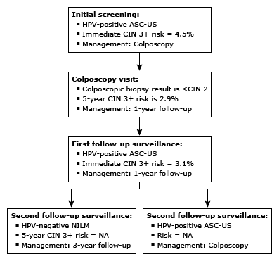

Slide 21
ASC-H or HSIL — CIN 1
an increased risk for subsequent high-grade disease
Concern that an underlying high-grade lesion has been missed by colposcopy and biopsy

Slide 22
In the study on 100,000 patients had colposcopic biopsies demonstrating CIN 1 and were followed for a decade, the risk of developing CIN 3+ when preceding cytology was ASC-H or HSIL was
For ASC-H – One- and five-year risks were 1.4 and 5.6 percent
For HSIL – One- and five-year risks were 3.9 and 6.5 percent
Managed more aggressively

Slide 23
Preceded by HSIL cytology
An immediate diagnostic excisional procedure or
Observation (HPV testing and colposcopy at one year)
Entire squamocolumnar junction (SCJ) and lesion are visible on colposcopy
The endocervical curettage (ECC) is less than CIN 2

Slide 24
Observation
Colposcopy and HPV-based testing are performed at one year; if negative, then repeat HPV testing is recommended in one year.
-If HPV testing continues to be negative, then repeat HPV testing is recommended in three years
-If any test is abnormal during observation, repeat colposcopy is recommended, and management is based on the biopsy result.
-If HSIL cytology is found at the one- or two-year visit, then a diagnostic excisional procedure is recommended.

Slide 25
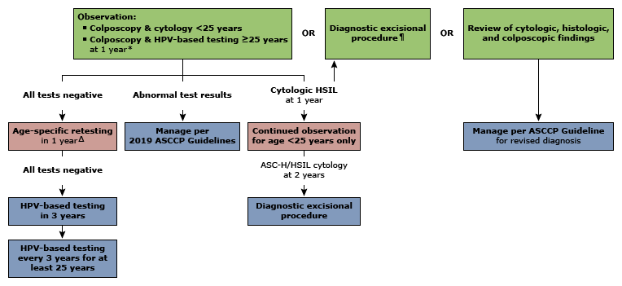

Slide 26
preceded by ASC-H cytology
Observation is recommended provided the entire SCJ and lesion are visible on colposcopy and an ECC, if collected, is negative. A diagnostic excisional procedure is not recommended.
-HPV-based testing is performed at one year; if negative, then repeat HPV testing is recommended in one year.
-If HPV testing continues to be negative, then repeat HPV testing is recommended in three years,( long-term surveillance )
-If any test is abnormal during observation, repeat colposcopy is recommended, and management is based on the biopsy result.
-If HSIL cytology is found at the one- or two-year visit, or if ASC-H is persistent at the two-year visit, then a diagnostic excisional procedure is recommended.

Slide 27
Preceded by ASC-H cytology

Slide 28
Persistent for two years
Persistent CIN 1 has a low risk of progression to CIN 3+
Observation is preferred. Co test in 1 year
Treatment with a diagnostic excisional procedure (LEEP, cold knife cone, and laser cone biopsy) or ablation (with cryotherapy, laser ablation, and thermo ablation)

Slide 29
CIN 2,3
Prompt treatment is recommended, with the exception of pregnant patients and patients younger than 25 years of age
Patient compliance is another factor to consider when deciding whether to treat or manage expectantly

Slide 30
nonpregnant patients ≥25 years
If histologic HSIL is unspecified (reported as histologic HSIL or HSIL [CIN 2,3] without distinction of CIN 2 or CIN 3):
Treatment is preferred; in these patients, CIN 3 cannot be excluded, and, therefore, patients are managed as if CIN 3 were present.
Observation (with colposcopy and HPV testing at 6 and 12 months) is acceptable.

Slide 31
If CIN 2 is specified
Treatment is recommended
Observation (with colposcopy and HPV testing at 6 and 12 months for up to two years) is acceptable if all of the following are present:
The patient's concerns about potential adverse pregnancy outcomes after an excisional procedure outweigh the concerns about cancer
The entire SCJ and lesion are visible on colposcopy, and ECC does not demonstrate CIN 2+ or ungraded CIN.

Slide 32
If CIN 3 is specified, if the entire SCJ or lesion are not visible on colposcopy, or if the ECC is CIN 2+:
Treatment is recommended
Hysterectomy is not acceptable for the primary treatment of HSIL (CIN 2 or 3).

Slide 33
clinical management of histologic HSIL

Slide 35
RECOMMENDATIONS
New-onset CIN 1 and (ASC-US), (LSIL), or (ASC-H), we recommend observation rather than treatment
Follow-up for these patients is with HPV testing in one year
Treatment rather than observation may be reasonable in some patients
long-term follow-up may be difficult,
completed childbearing and are not concerned about future obstetric complications

Slide 36
ASC-US
CIN 1 , Age>25y
co test 1y

Slide 37
RECOMMENDATIONS
Persistent CIN 1 ( lesions present for ≥2 years), we continue to prefer observation, but treatment is also acceptable

Slide 38
RECOMMENDATIONS
CIN 1 and a preceding lesion of high-grade squamous intraepithelial lesion (HSIL) or CIN 2, treatment or observation is acceptable
For most patients, we suggest treatment rather than observation

